Slide 1
Resilient Distributed Datasets: A Fault-Tolerant Abstraction for In-Memory Cluster Computing Kevin | Jonas
Zaharia, Matei & Chowdhury, Mosharaf & Das, Tathagata & Dave, Ankur & Ma, Justin & McCauley, Murphy & Franklin, Michael & Shenker, Scott & Stoica, Ion. (2012). Resilient distributed datasets: A fault-tolerant abstraction for in-memory cluster computing. Proceedings of the 9th USENIX Conference on Networked Systems Design and Implementation. 2-2.
https://www.usenix.org/system/files/conference/nsdi12/nsdi12-final138.pdf

Slide 2
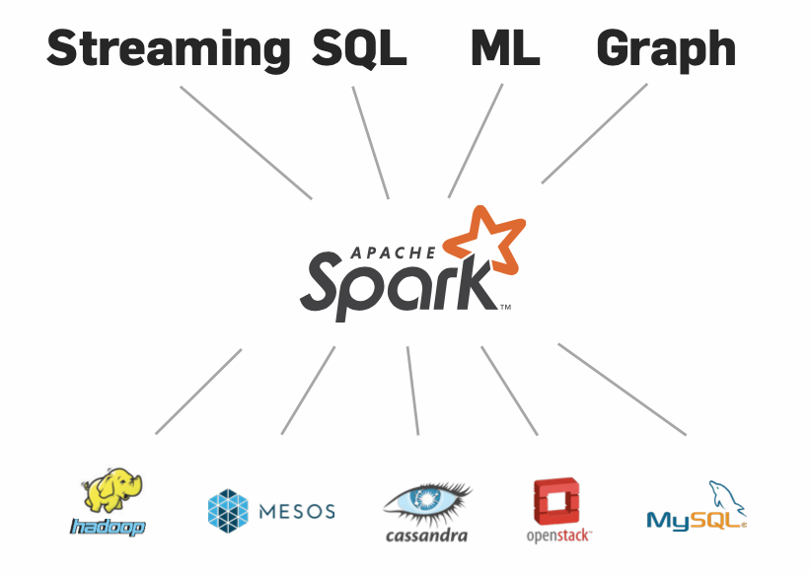
Context and Motivation
Source: https://dl.acm.org/doi/10.1145/2934664
Notes:
Present the generic context of the paper and explain why it is important to work on this topic (e.g., faults in distributed systems)
THE GROWTH OF data volumes in industry and research poses tremendous opportunities, as well as tremendous computational challenges. As data sizes have outpaced the capabilities of single machines

Slide 3
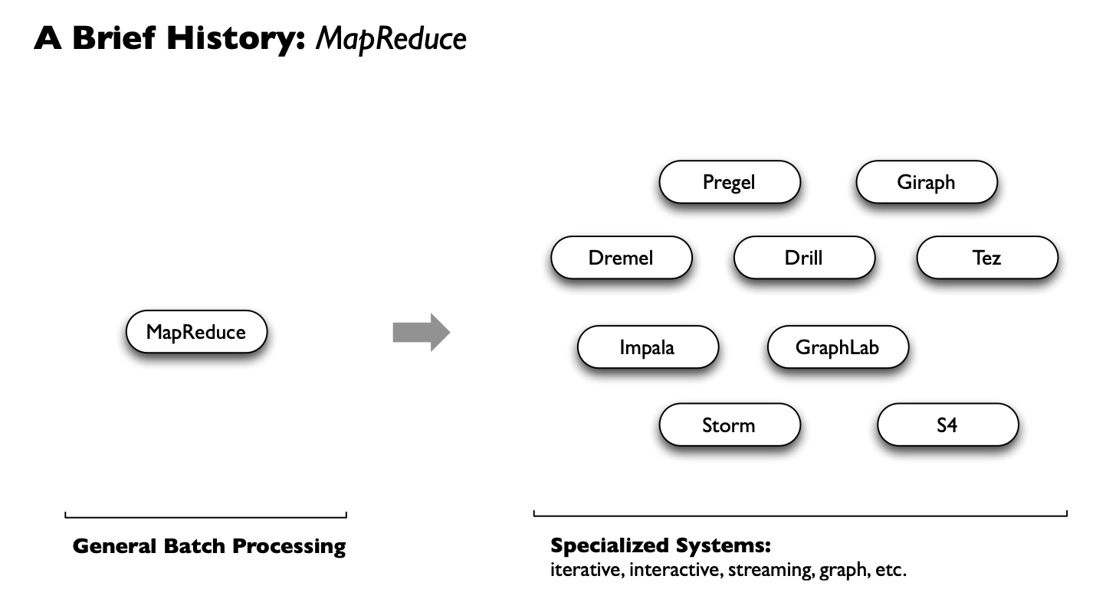
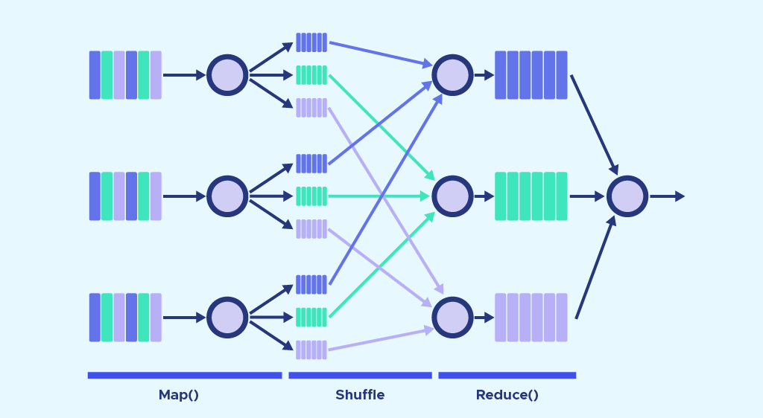
Problem Statement and related work
Source: https://datascientest.com/mapreduce
Source: https://stanford.edu/~rezab/sparkclass/slides/itas_workshop.pdf
Notes:
Explain what is the research problem that is addressed in this paper (e.g., dealing with selfish behaviours in live streaming applications)
Explain why this problem is important to deal with (e.g., 5% of nodes act selfishly => 70% of nodes can not visualise the video stream)
Explain existing solutions that exist for solving the problem and why there is no satisfactory solution

Slide 4
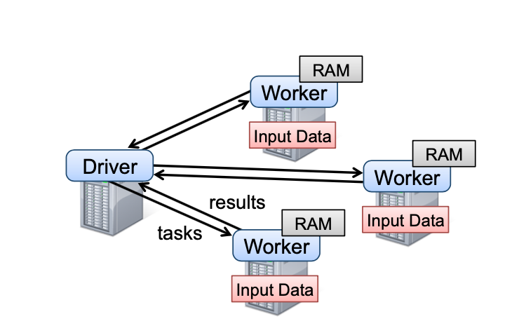
Contribution: RDDs
Resilient Distributed Datasets (RDDs)
Immutable
Resilient
Distributed
Fault-Tolerant
lazily evaluated
Notes:
Explain what the authors propose to solve the problem (this includes the architecture of the proposed system, and its underlying protocols if any)
Your class mates should be able to take something away from your presentation

Slide 5
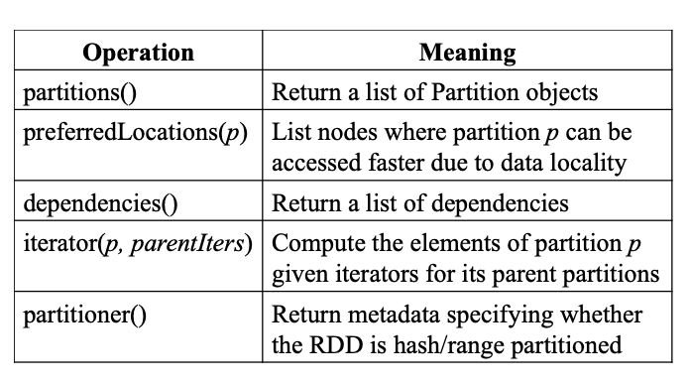
Contribution: RDDs
RDD Representation:
a set of partitions, which are atomic pieces of the dataset;
a set of dependencies on parent RDDs;
a function for computing the dataset based on its parents;
metadata about its partitioning scheme
data placement.

Slide 6

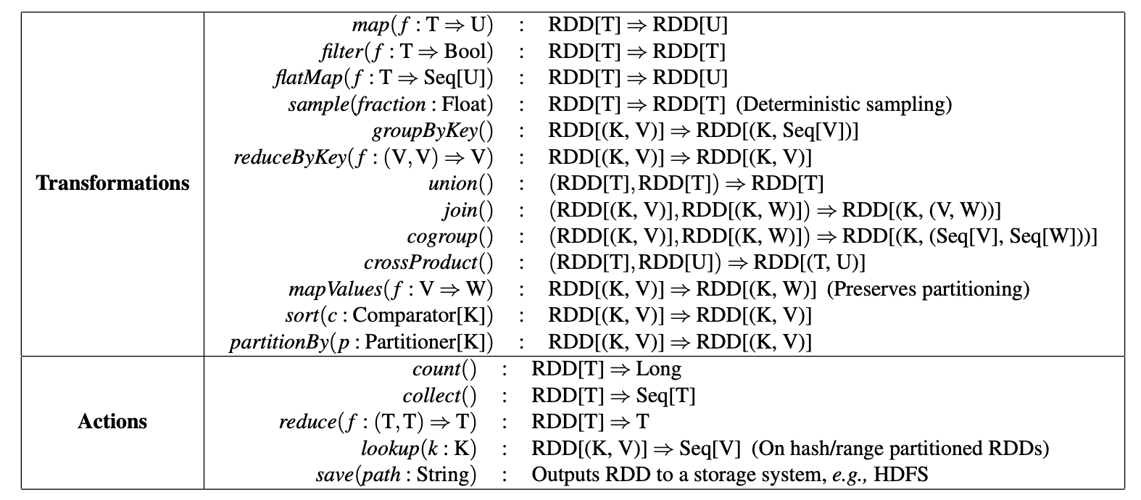
Contribution: RDDs

Slide 7
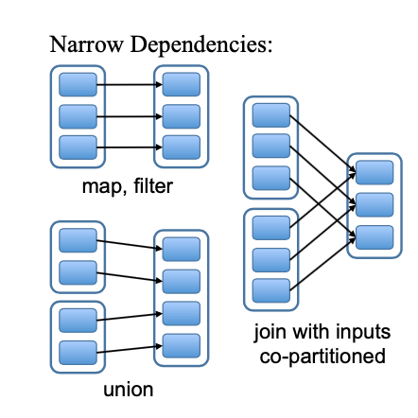
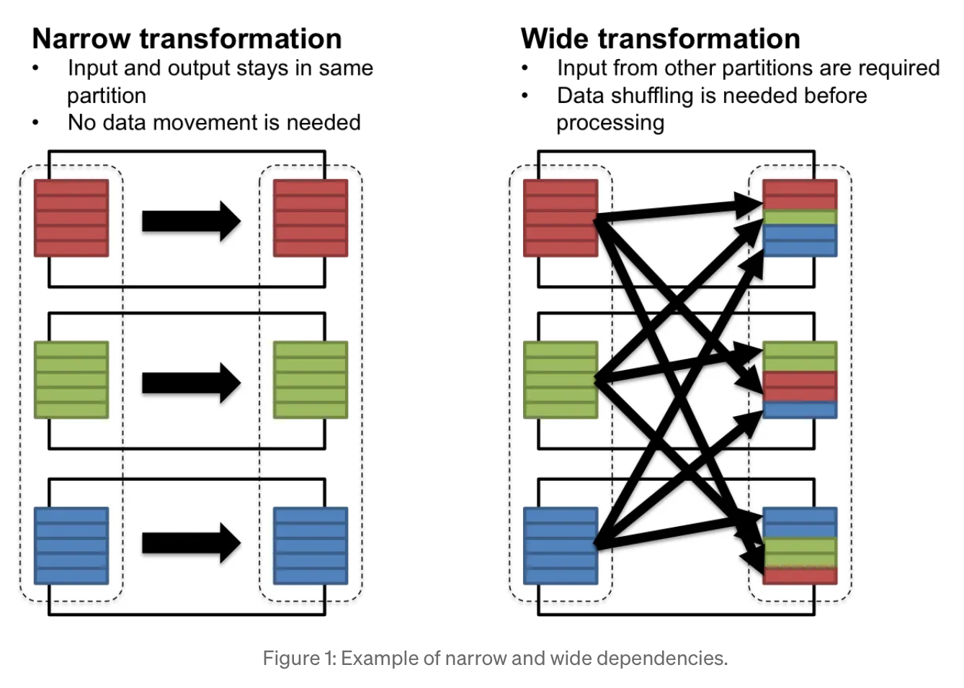
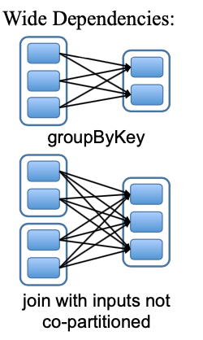
Contribution: RDDs
Source: https://medium.com/@shagun/resilient-distributed-datasets-97c28c3a9411

Slide 8
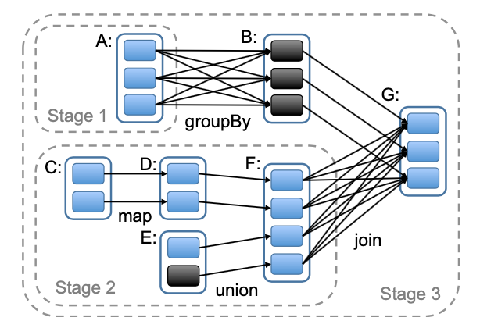
Contribution: RDDs

Slide 9
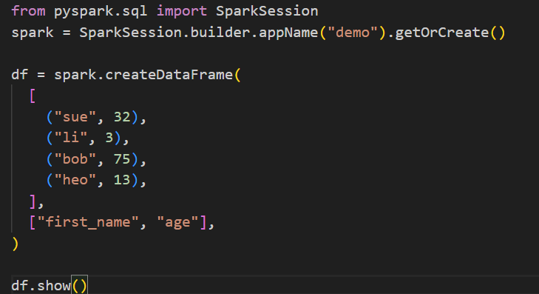
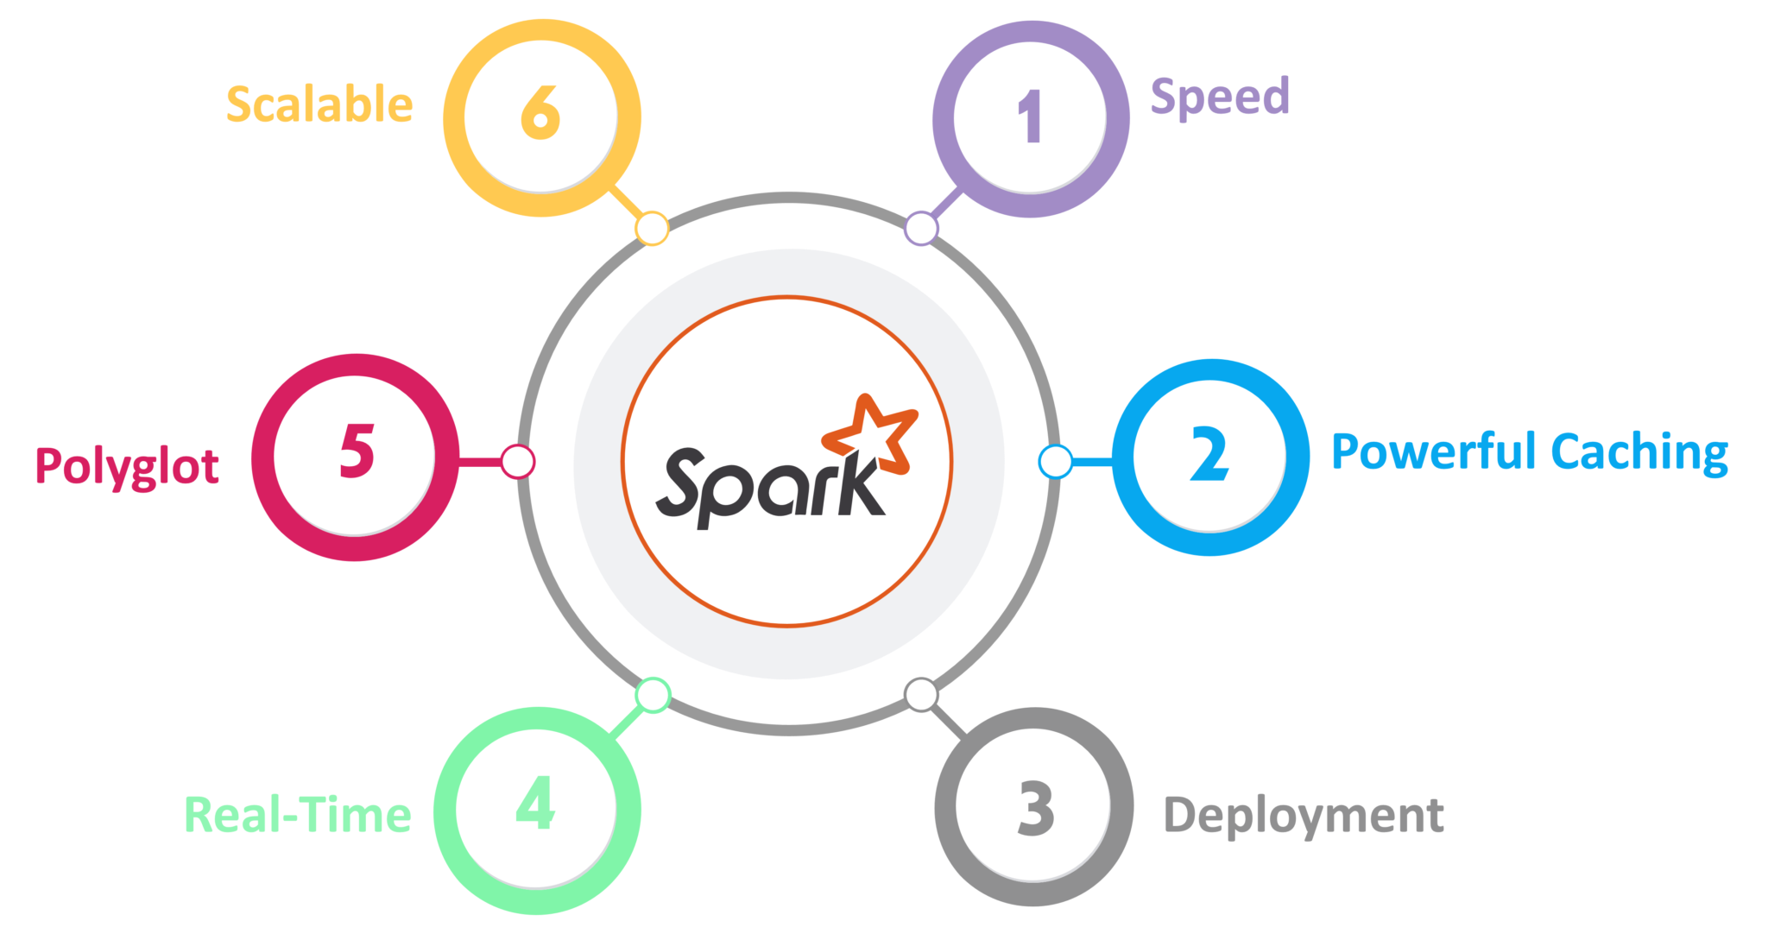
Pros and cons
To learn it you just need to know how to code in one of these languages :
Java
Python
Scala
It is Polyglot and have built-in libraries that help the process !

Slide 10
Pros and cons
MLib
SQL
Streaming
GraphX
Active community
Open Source framework innovations
Developer-Friendly

Slide 11
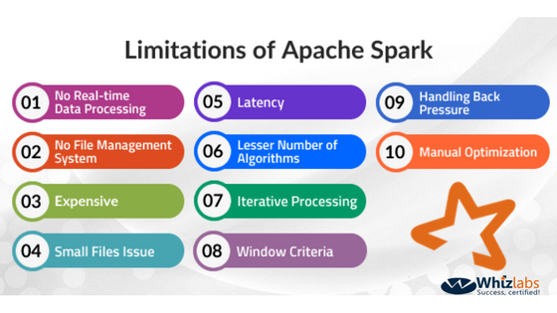
Pros and cons

Slide 12
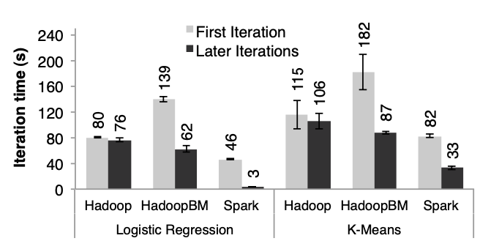
Evaluation
Notes:
Explain how the proposed solution is evaluated
What are the competitors they compare against?
Did they run real experiments or simulations?
What are the workloads/datasets they used?
What are the main results?
Etc.

Slide 13
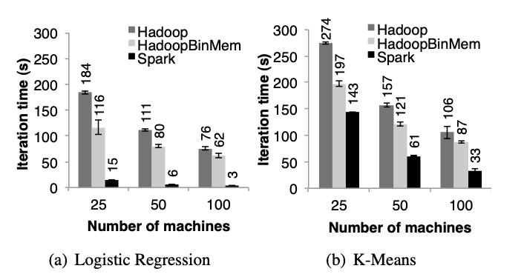
Evaluation

Slide 14
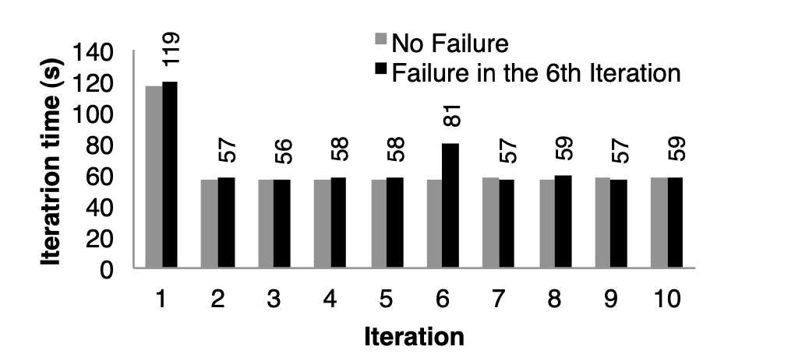
Evaluation

Slide 15
Conclusion & Future Work
Interesting technology, and easy to access
Expensive
Used for social media analysis, fraud detection.
Interactive data mining project with Spark in the future
Notes:
Discuss the pros and cons of the proposed solution (your personal opinion, not the one of ChatGPT)
Is the proposed solution used in real life?
Where there evolutions since it was proposed?
What are the open research problems in this topic

Slide 16






Who uses Spark ?
Notes:
https://mindmajix.com/apache-spark-usecases

